Slide 1

M V S ◆ Weekly Review
Weekly Progress & IT Assets
2026 Week 46, 12/11/2026
MVS ICT & Telecom
Weekly Presentation
Presenter: Danish Akbar
Position: IT Support

Slide 2
M V S ◆ WEEKLY OPERATIONS
Weekly Progress & Next Steps (Week 46)
◆ MVS Sales & Projects Web Portal
✓ LIVE & OPERATIONAL
◆ Salam CCS — KPI Framework
● IN PROGRESS (40%)
• Live Deployment: Operational at portal.mvsksa.com with active SSL encryption.
• Team Onboarding: All user accounts created with official MVS emails and default credentials.
• Live Data Entry: Sample records cleared; live pipelines and projects being actively entered.
• Master Excel Sync: Dynamic export engine providing clean OneDrive master tracking files.
• Data Integration: Received patrolling and supervisor tracking data from Mr. Tahir Anjum.
• Scoring Models: Structuring calculation formulas for SLA compliance, CMR/PMR, and team rankings.
• Executive Scorecard: Designing consolidated dashboard view for weekly management review.
◆ FO Route Survey Application (DCP-1)
◆ ONGOING SUPPORT
◆ IT Infrastructure & Asset Governance
✓ ON TRACK
• Survey Operations: Ongoing QA alignment checks, utility classifications, and highway mapping.
• Field & Data Backups: Continuous KMZ exports, database integrity backups, and survey team sync.
• Hardware & SIM Custody: Managing 83 hardware units (79 in use, 4 in stock) and 50 telecom lines.
• Week 46 Procurement: Procured & deployed 6 LG 27" UltraGear monitors and cables (5,148 SAR, Jarir).
• Daily IT Support: Workstation maintenance, network support, and meeting room AV readiness.
Modern Vision Solutions 2026 • MVS ICT & Telecom Slide 2 of 3

Slide 3
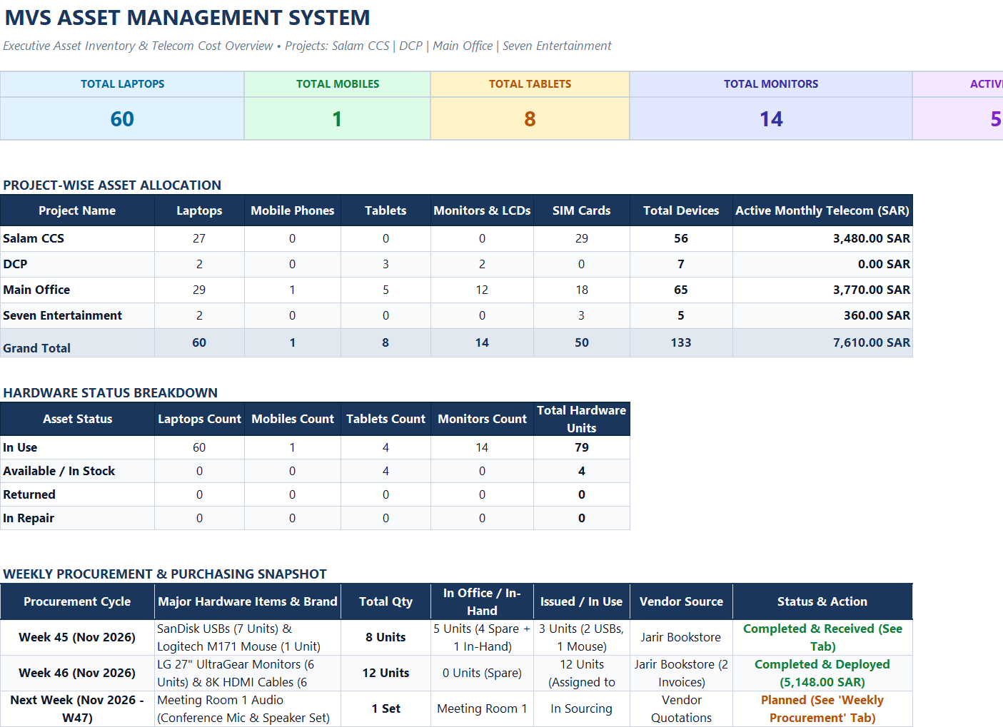
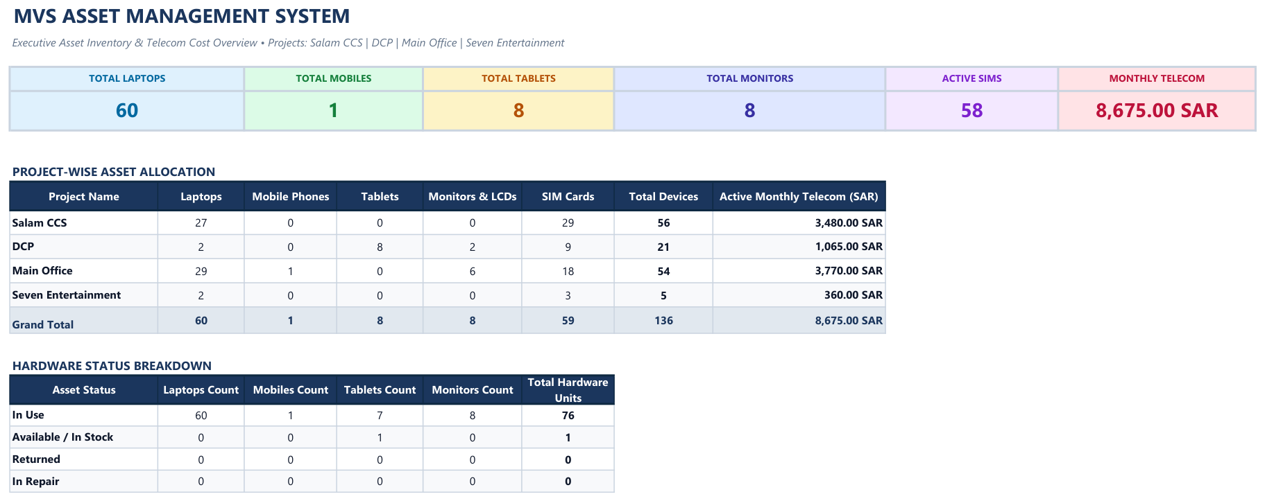
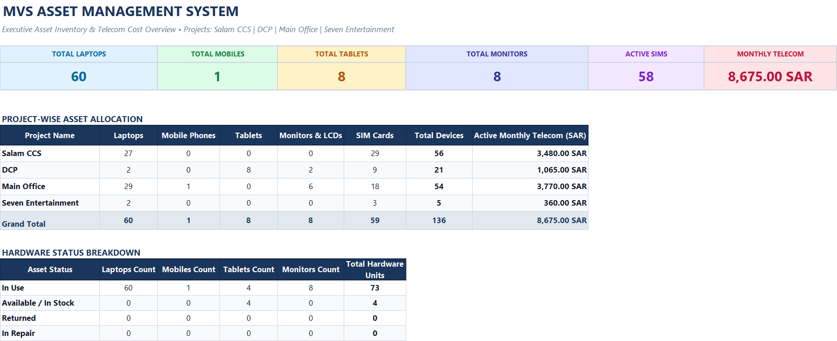
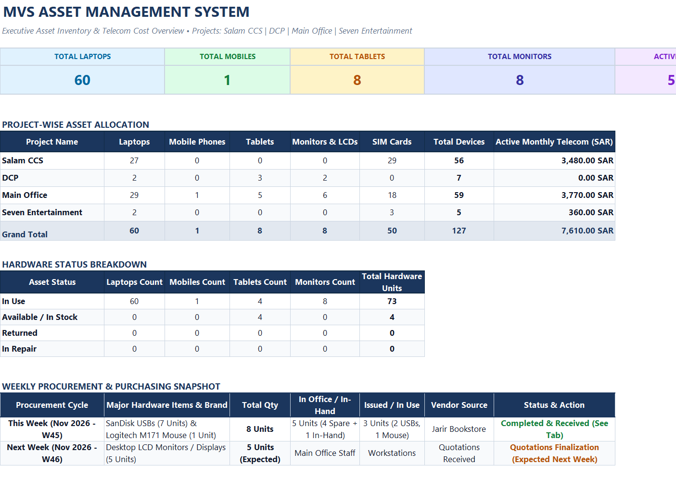
M V S ◆ ASSET MANAGEMENT
IT Assets & Telecom Inventory Dashboard
Modern Vision Solutions 2026 • MVS ICT & Telecom Slide 3 of 3

